Slide 1

Introduction of Open Data Policy and License
開放資料政策與授權介紹
Lucien Cheng-hsia Lin / 林誠夏
Email: lucien@citi.sinica.edu.tw
TEL: +886-2-27883799 #1474
For 2013 International Conference on Open Data in Biodiversity and Ecological Research
(2013生物多樣性及生態研究開放資料國際研討會暨工作坊)
Except where otherwise noted, content on this slide is licensed under a Creative Commons
Attribution-ShareAlike 3.0 Unported license

Slide 2
lucien@citi.sinica.edu.tw
林誠夏/Lucien
(02)27883799 EXT.1474

Slide 3
lucien@citi.sinica.edu.tw
兵林誠夏/Lucien
(02)27883799 EXT.1474

Slide 4
OSSF, CITI,
Academia Sinica

Slide 5
OPEN SOURCE SOFTWARE FOUNDRY,
OSSF
http://www.openfoundry.org/en/about

Slide 6
Analysis and interpretation of General Public Licenses
Open Source Software License
Creative Commons, Open Data License
Email at lucien.cc@gmail.com
Linkedin at http://tw.linkedin.com/in/lucienchlin

Slide 7
Outline
What is General Public License
Crucial things you should know about Open Data
Open Data in General Public Licensing way

Slide 8
1. What is General Public License

Slide 9
General Public
Unspecific Commons

Slide 10
License
granting the rights for utilization

Slide 11
License
Various rules about the utilization

Slide 12
General Public License

Slide 13
Granting some rights to many people by pre-declaring many rules

Slide 14
Right Holder: People can utilize my work, implement it, redistribute it, or even rewrite it at their own will, BUT, the rules predeclared must be followed.

Slide 15
This is so-called OPEN nowadays

Slide 16
OPEN to the Public

Slide 17
But WHY?

Slide 18
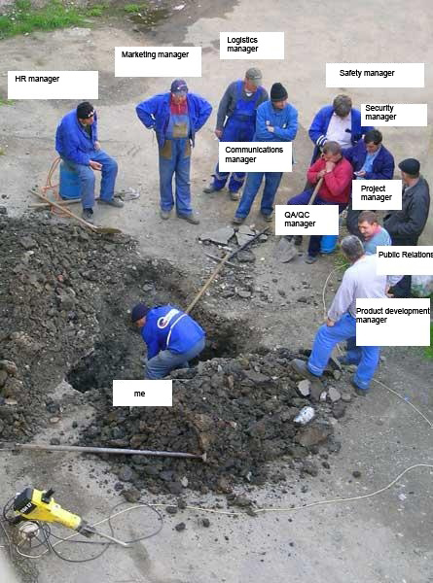
The one who actually
did the software development.
FAIR USE in the speech of Open Source and Open Data outreach and promotion activities.

Slide 19
OPEN

Slide 20
∅
bureaucracy

Slide 21
The World Is Flat: A Brief History of the Twenty-first Century
《世界是平的：一部二十一世紀簡史》

Slide 22

Cover of The World Is Flat by Thomas Friedman
FAIR USE at: http://upload.wikimedia.org/wikipedia/zh/d/d1/Worldisflat.gif

Slide 23
全球化
Globalization

Slide 24
OPEN
1. Open the materials for everyone willing to follow the rules carried in the LICENSE.
2. People can participate the project at will for cooperation.
3. Joint works can therefore be produced in crowdsourcing way without coordination.

Slide 25
1. Don't have to reinvent the wheel
2. Cooperation without coordination

Slide 26

FAIR USE at: http://www.mysql.com/

Slide 27
2. Crucial things you should know about Open Data

Slide 28
Free and Open Source SOFTWARE
Free to modify & redistribute

Slide 29
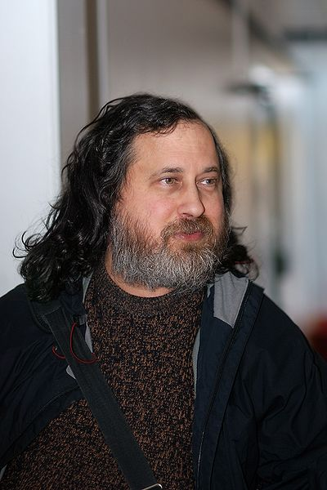
Richard M. Stallman
©Gisle Hannemyr, CC by-sa 3.0 unported, http://en.wikipedia.org/wiki/File:Rms_ifi_large.jpg

Slide 30
GNU Project
“GNU's Not Unix!”

Slide 31
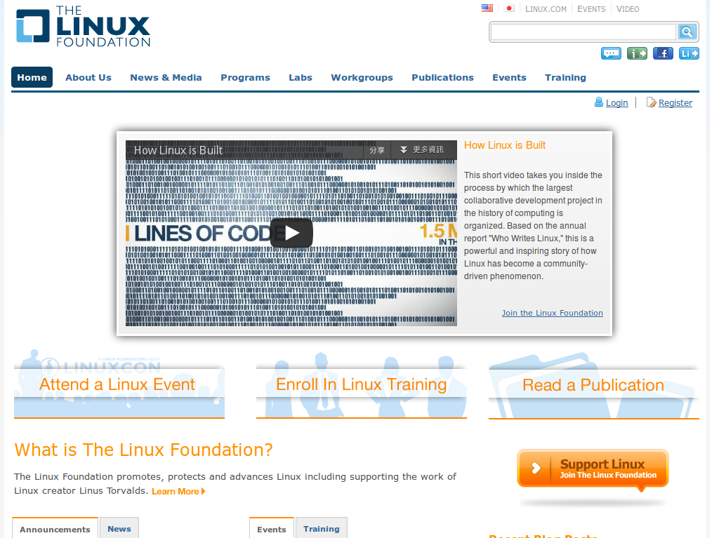

Slide 32
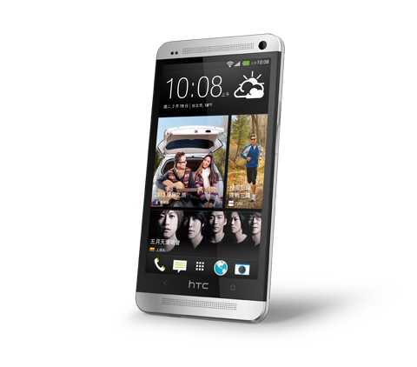
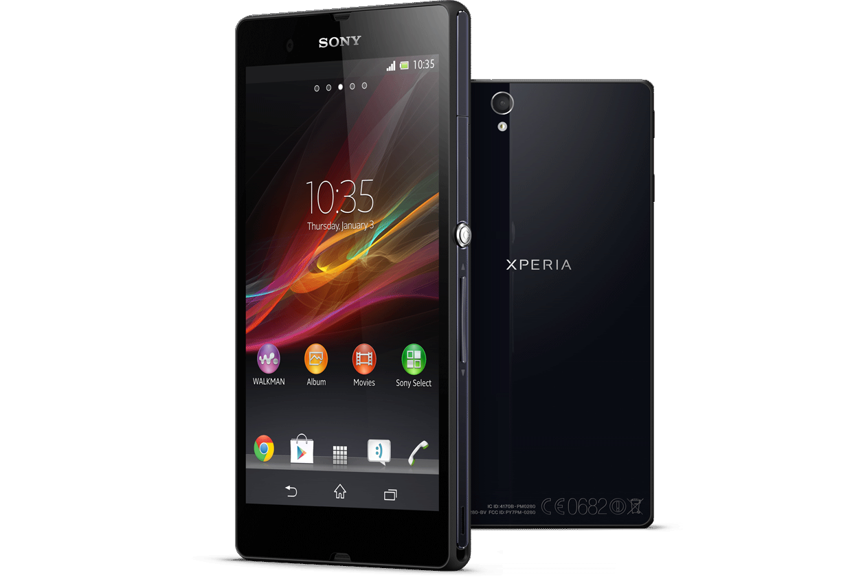


Slide 33
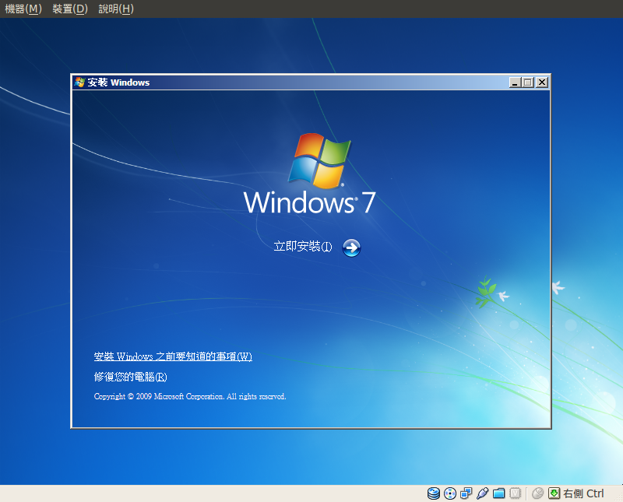

Slide 34
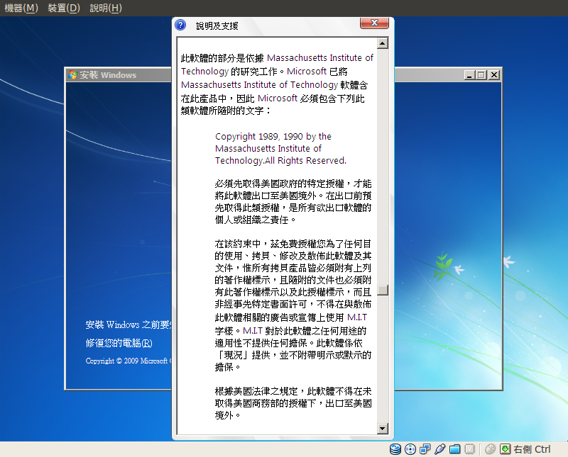

Slide 35
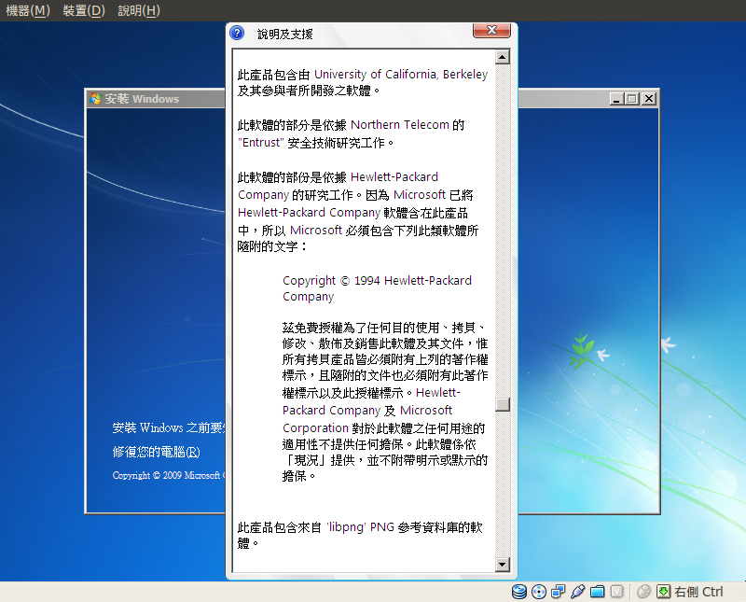

Slide 36


Slide 37
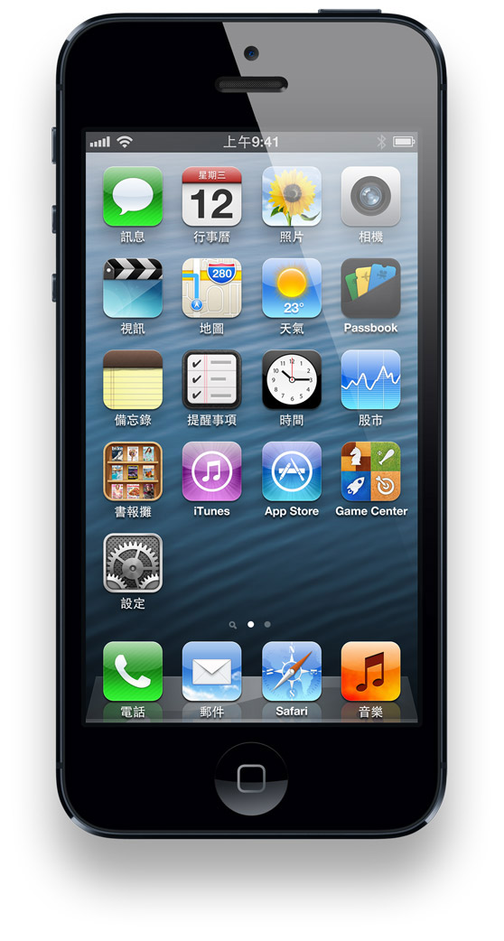

Slide 38
Open Content MATERIAL
Free to redistribute & reuse or remix

Slide 39
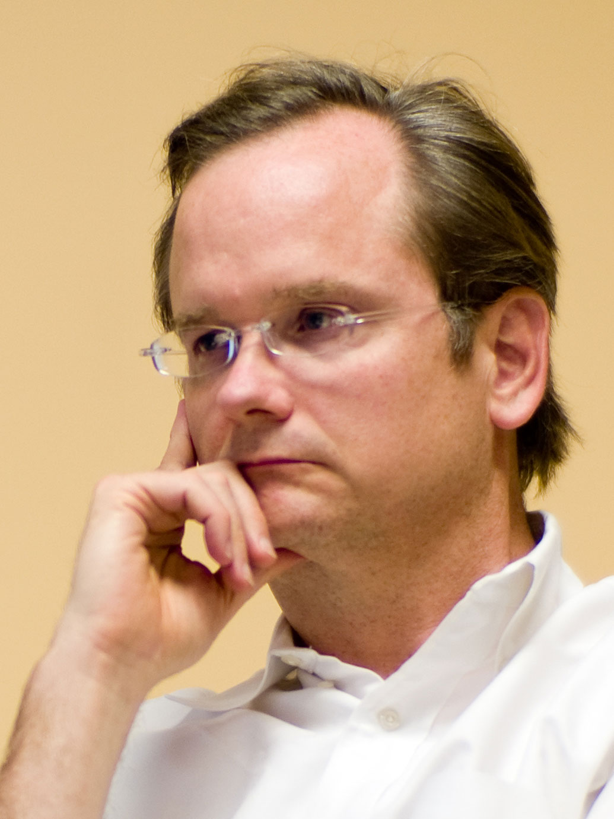
Lawrence Lessig
2008 Ⓒ Joi Ito, released under Creative Commons Attribution 2.0 Generic license at: http://flickr.com/photos/35034362831@N01/2072756557

Slide 40
Creative Commons
“Sharing Creativity ”

Slide 41
創用CC
Creative Commons License

Slide 42


Slide 43





Slide 44







Slide 45
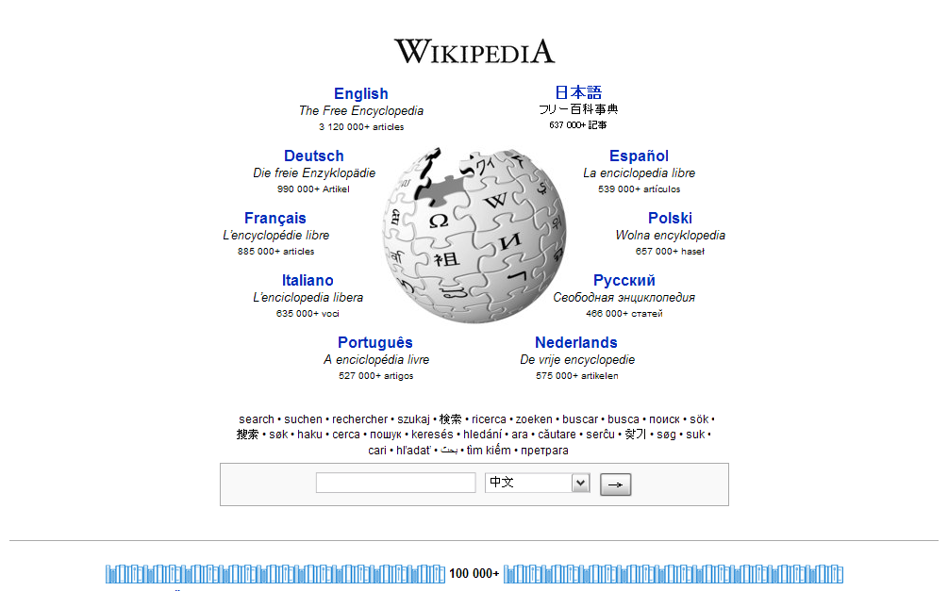
Wikipedia (www.wikipedia.org)

Slide 46
Open Hardware PRODUCT
Free to implement & re-design

Slide 47
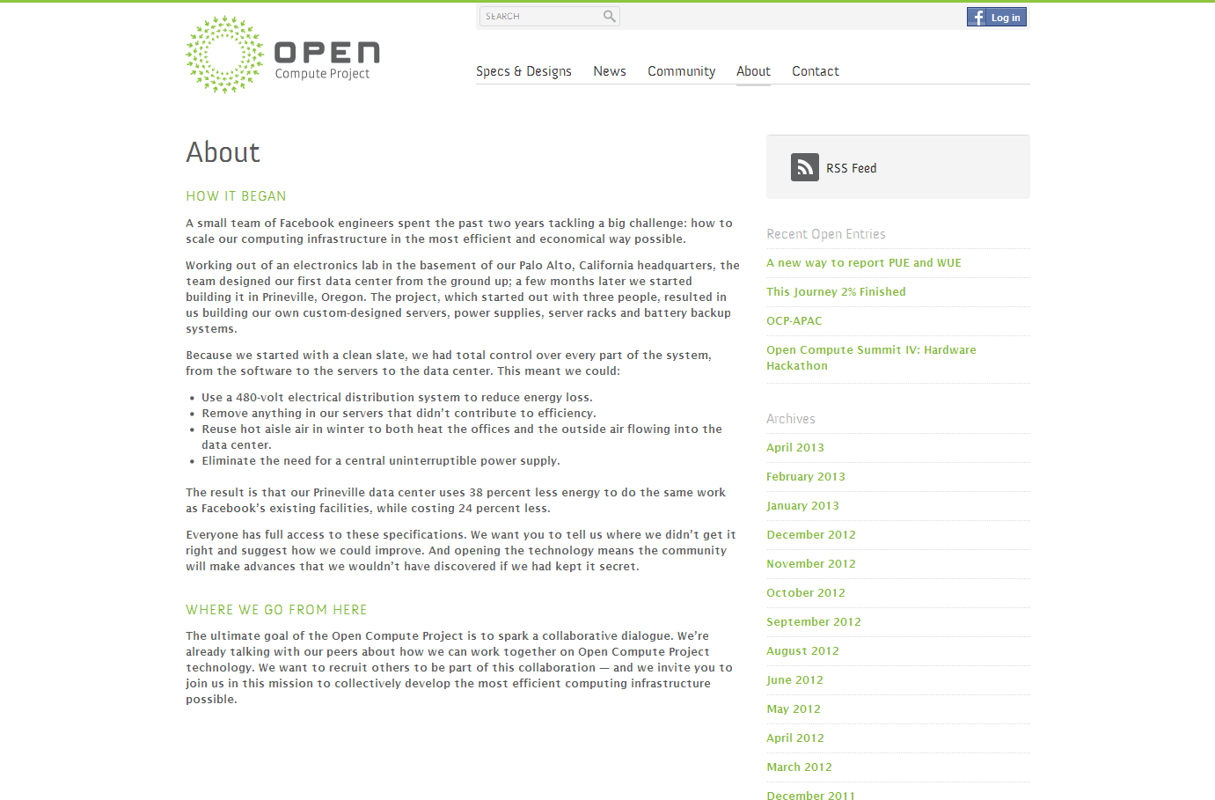

Slide 48
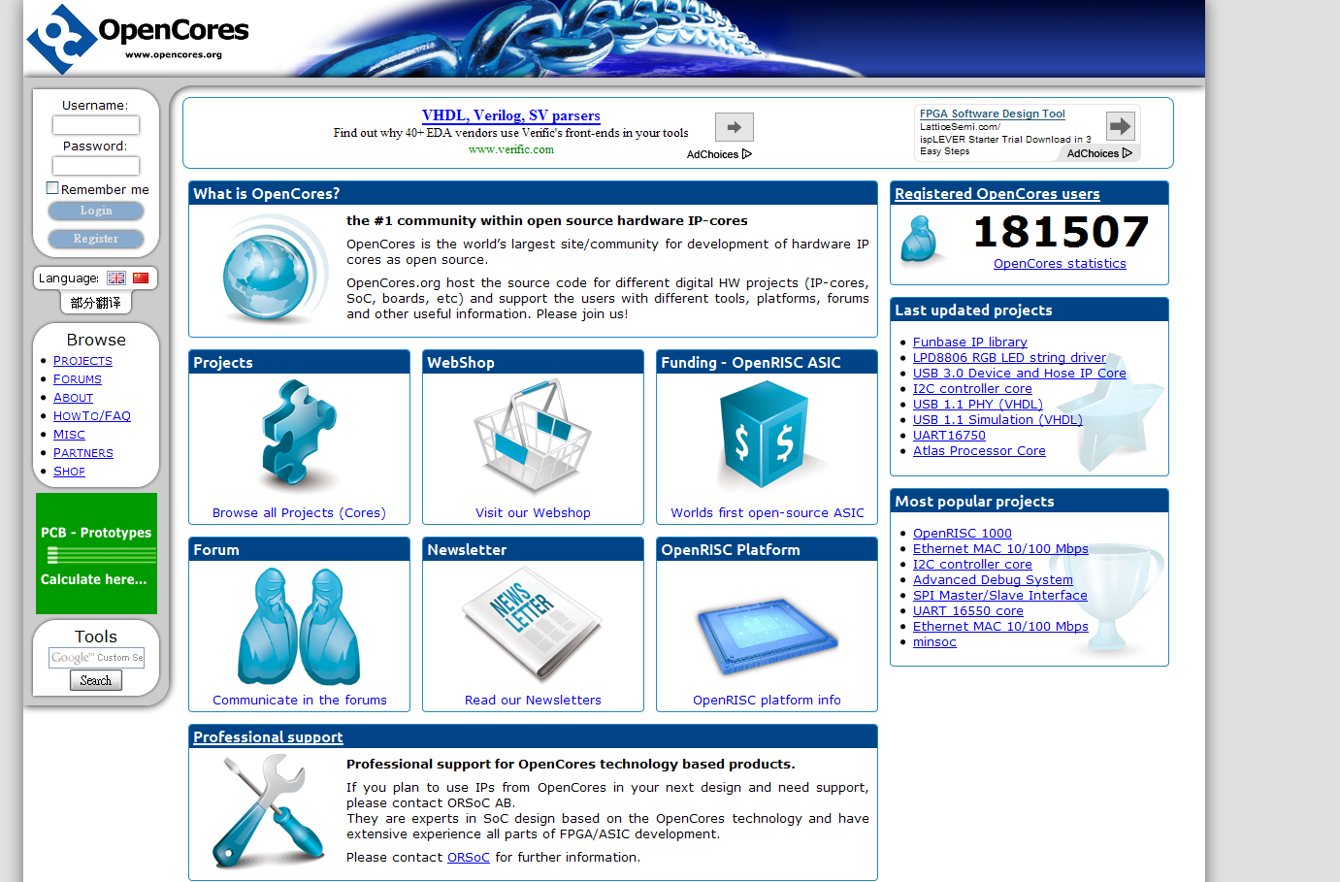

Slide 49
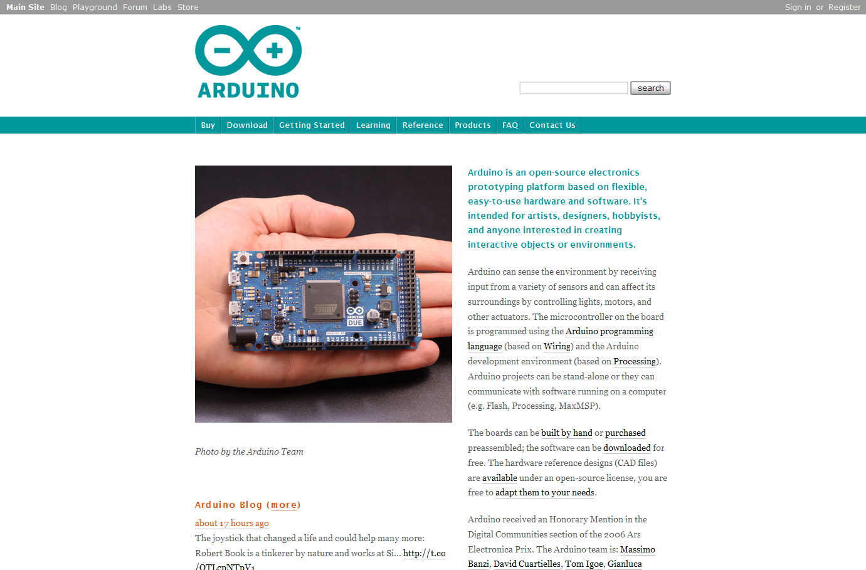

Slide 50
Open Data POLICY
Free to access & use

Slide 51

Barack Obama
Work pertained to U.S. Government without copyright restrictions under U.S. copyright laws at: http://farm6.staticflickr.com/5535/9515309159_34e7ecb686_o.jpg

Slide 52
Digital Government
“Open Data & Content”

Slide 53
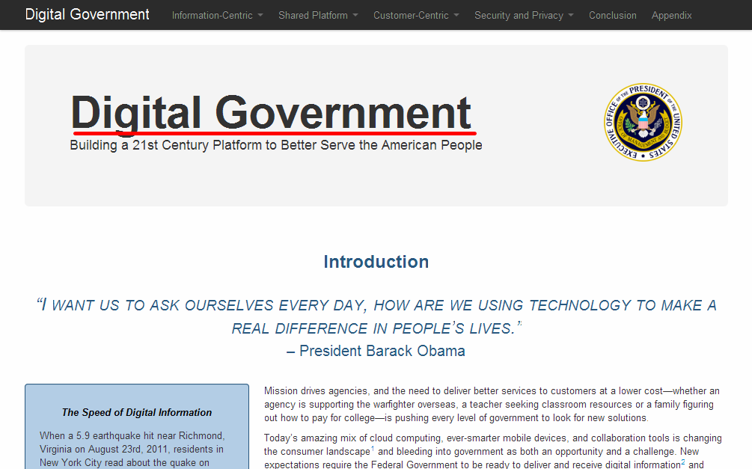
http://www.whitehouse.gov/sites/default/files/omb/egov/digital-government/digital-government.html

Slide 54
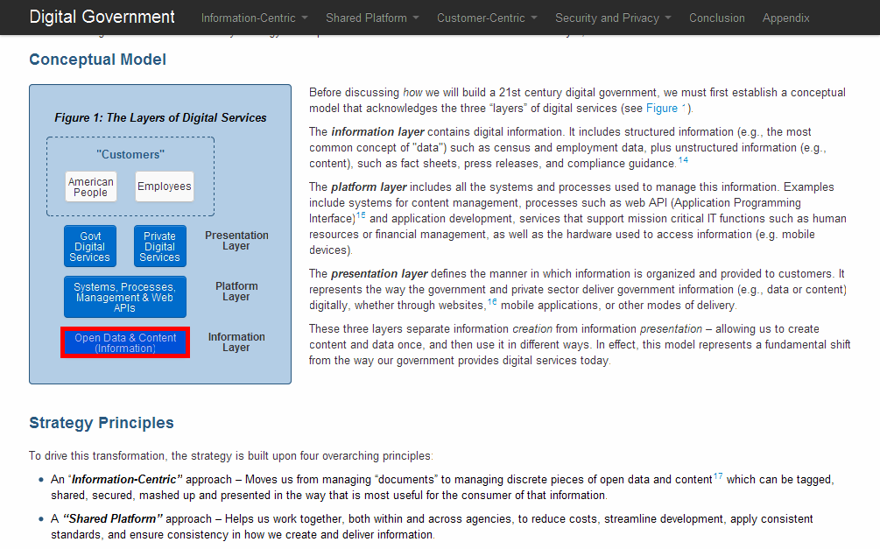
http://www.whitehouse.gov/sites/default/files/omb/egov/digital-government/digital-government.html

Slide 55
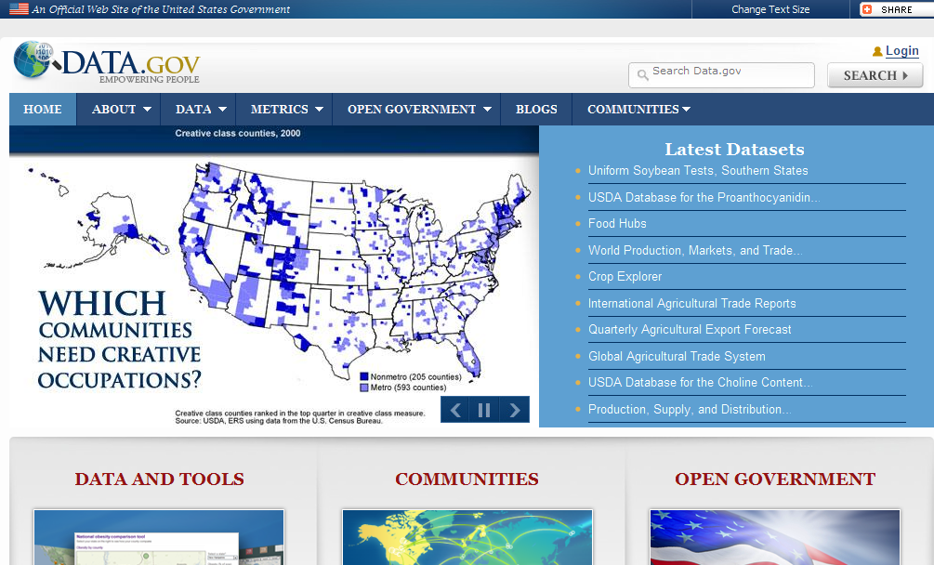
http://data.gov/

Slide 56
OPEN SOURCE Software
OPEN CONTENT Material
OPEN HARDWARE Product
OPEN DATA Policy

Slide 57
Crucial Things
1. Bigger
2. Various
3. Vague

Slide 58
1. Bigger
Big Data vs. Open Data

Slide 59
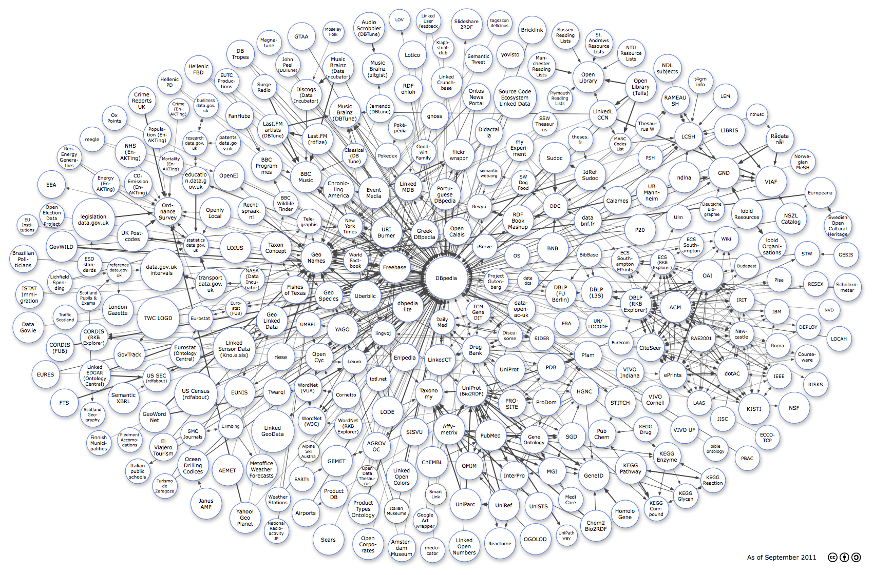
“Linking Open Data cloud diagram, by Richard Cyganiak and Anja Jentzsch. http://lod-cloud.net/”

Slide 60
2. Various
Media
Geographic
Publications
User-generated Content
Government
Cross-domain
Life Sciences

Slide 61
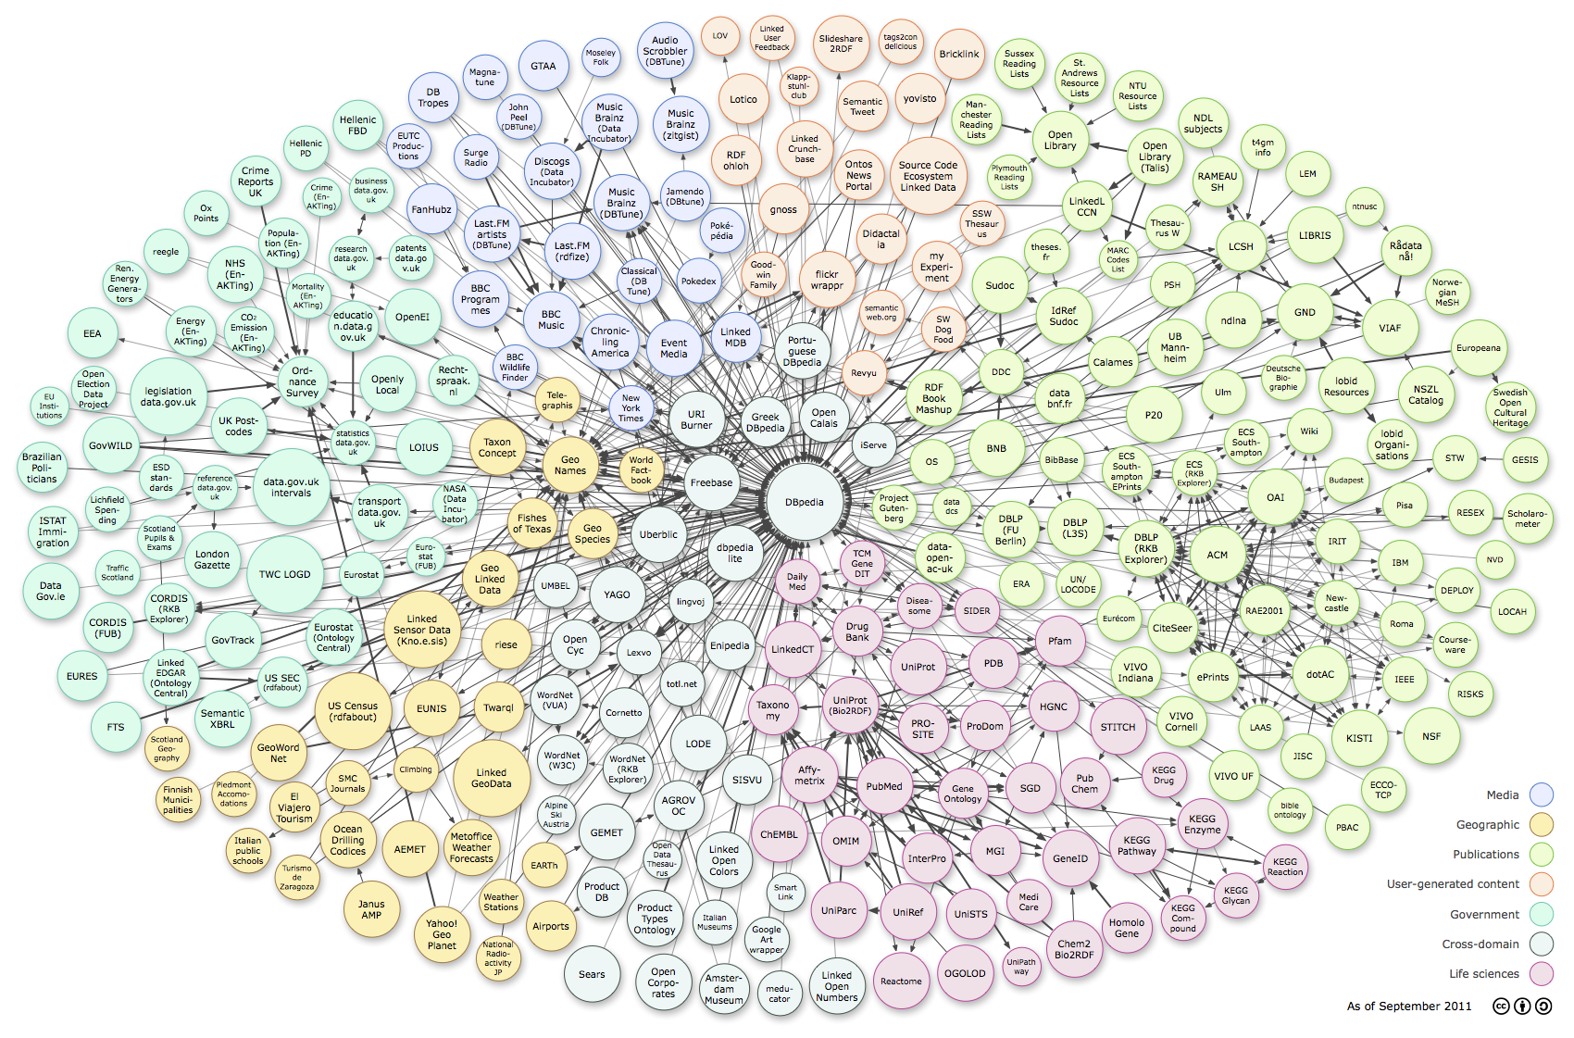
“Linking Open Data cloud diagram, by Richard Cyganiak and Anja Jentzsch. http://lod-cloud.net/”

Slide 62
3. Vague
All Rights Reserved vs. No Rights Deserved

Slide 63
IP
Intellectual Property

Slide 64
Free and Open Source SOFTWARE
COPYRIGHT、PATENT

Slide 65
Open Content MATERIAL
COPYRIGHT and its NEIGHBORING RIGHT

Slide 66
Open Hardware PRODUCT
COPYRIGHT、PATENT、CIRCUITLAYOUT RIGHT、RIGHTS IN REM

Slide 67
Open Data POLICY
COPYRIGHT、DATABASE RIGHT

Slide 68
Trade-Related Aspects of Intellectual Property Rights (TRIPS), WTO
Compilations of data or other material, whether in machine readable or other form, which by reason of the selection or arrangement of their contents constitute intellectual creations shall be protected as such. Such protection, which shall not extend to the data or material itself, shall be without prejudice to any copyright subsisting in the data or material itself.(資料或文獻經整理成為編輯著作之後，可為智慧財產權協定所保護，但其中的資料本身若並未具有人類智慧的創作性，則不應被擴及保護到。)
http://www.wto.org/english/docs_e/legal_e/legal_e.htm#TRIPs

Slide 69
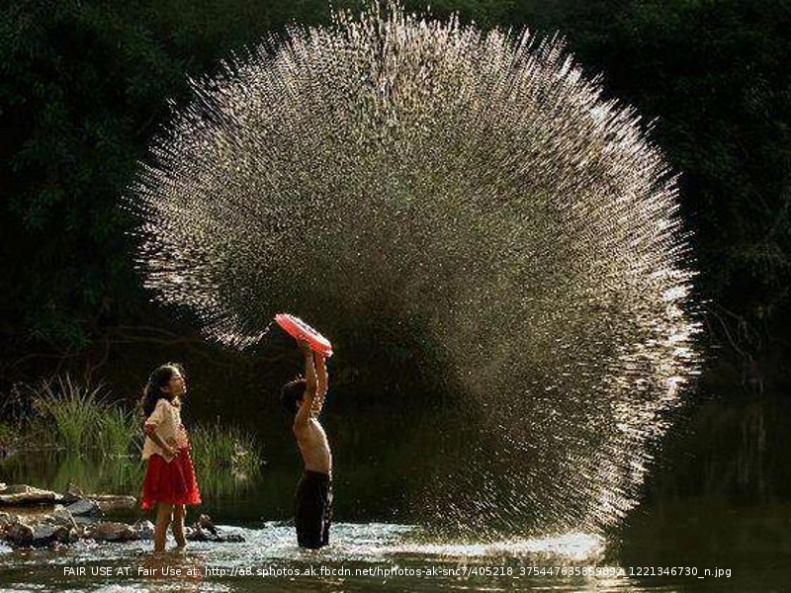

Slide 70
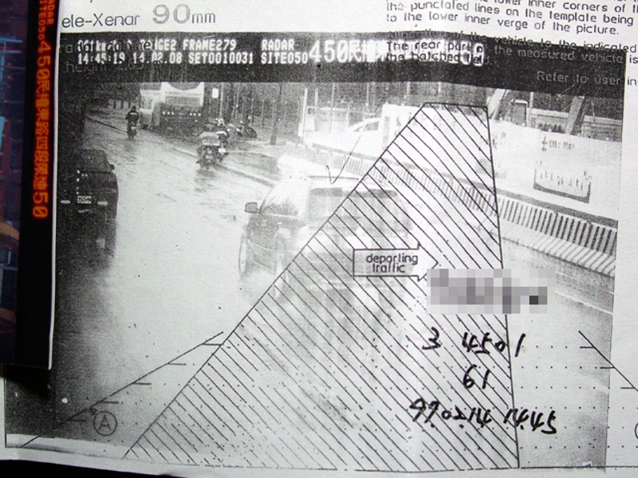
Download at: http://www.wacow.net/wordpress/wp-content/uploads/2008/05/dscf8187.JPG

Slide 71
What is Open Data ?
Transparency、Valued-add Tendency

Slide 72
What is Open Data ?
1、The right to get access to the Data.
2、The privilege of utilizing the Data.

Slide 73
Open Data:
1. License – utilization granting
2. Standardizing - linking the dataset to another dataset
3. Policy – how to bring in industry innovation and livelihood convenience via Data utilization as many as possible

Slide 74
3. Open Data in General Public Licensing way

Slide 75
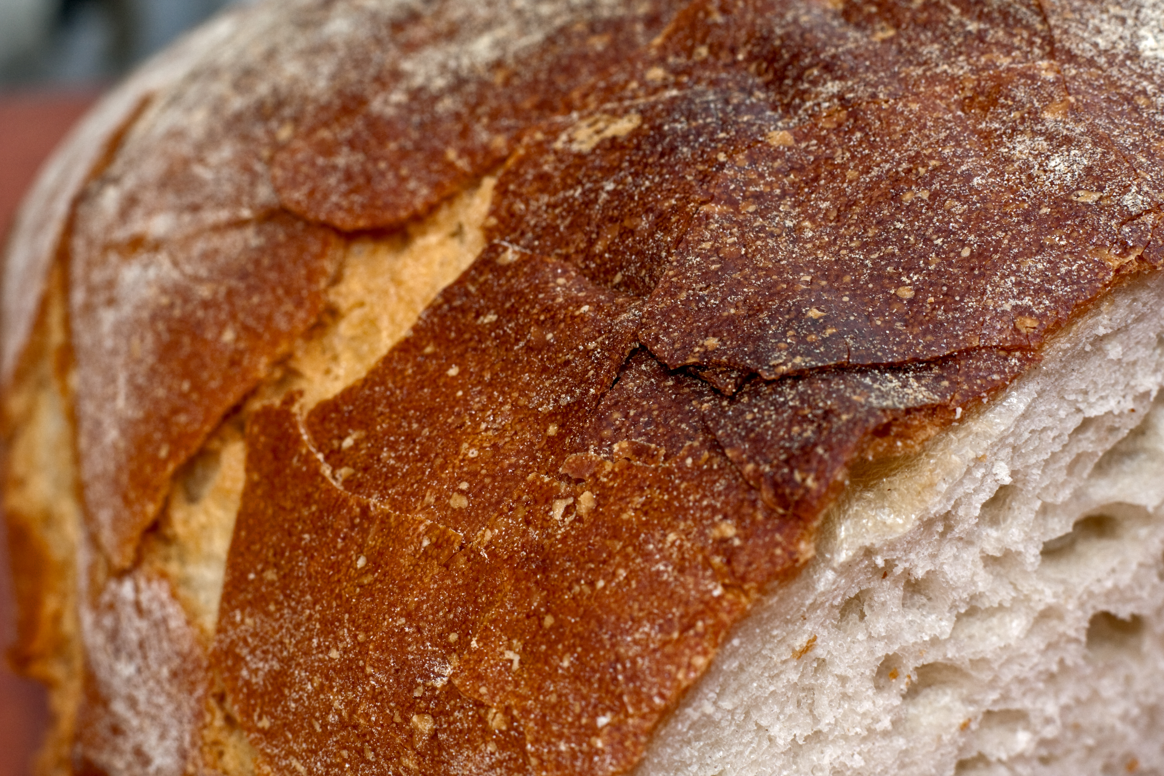
2008 Ⓒ Horia Varlan, released under CC-BY-unported-2.0 at: http://farm5.staticflickr.com/4011/4268974682_3e8ca96d12_o.jpg

Slide 76
Open Data Licensing and Releasing Policies
Use non-proprietary and interoperable formats
No restriction on access people and grant area
No royalty on Data should be charged in further redistribution
The granted Data can't be revoked
No warranties / Correctness timely updating obligation only
The status to use, research, value-add, and redistribute the Data

Slide 77
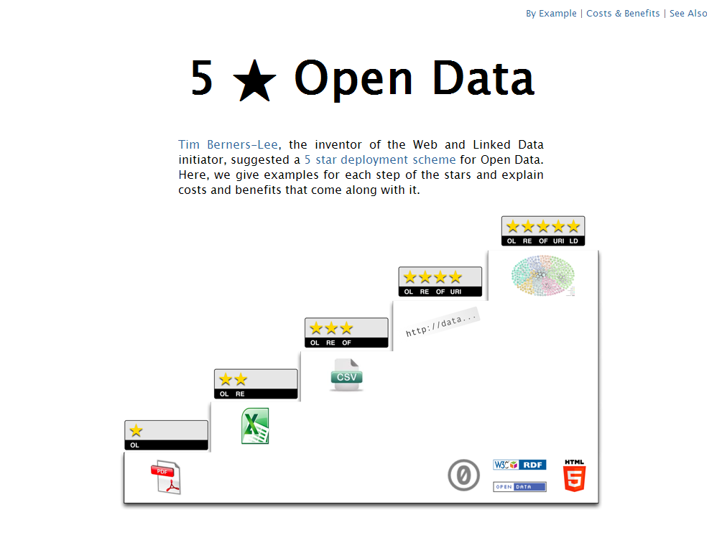
1. Use non-proprietary and interoperable formats
http://5stardata.info/

Slide 78
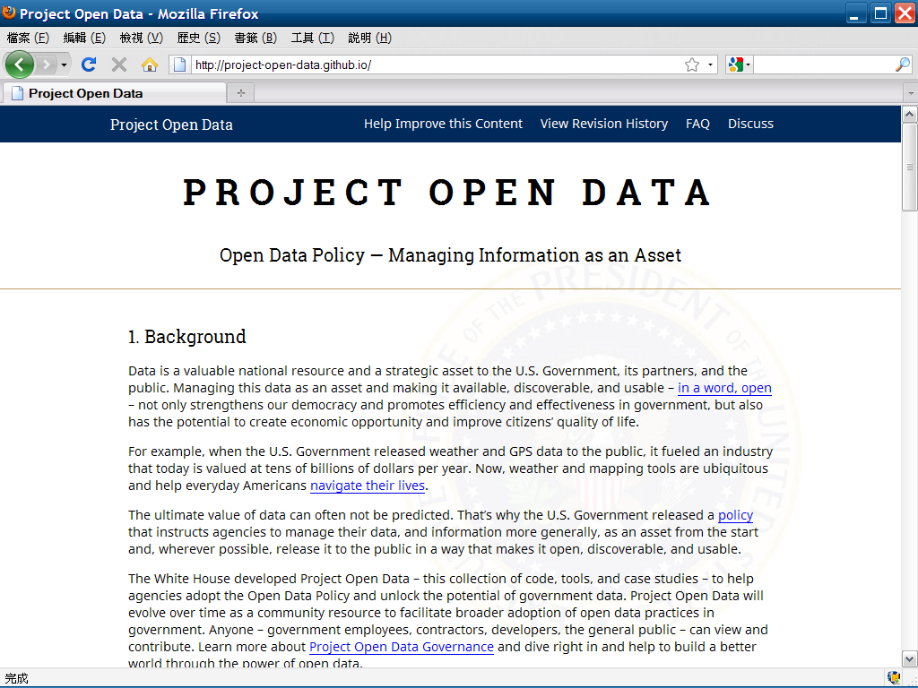
2. No restriction on access people and grant area

Slide 79
3. No royalty on Data should be charged in further redistribution
✘
Licensing Subject
Licensing Period
Licensing Area

Slide 80
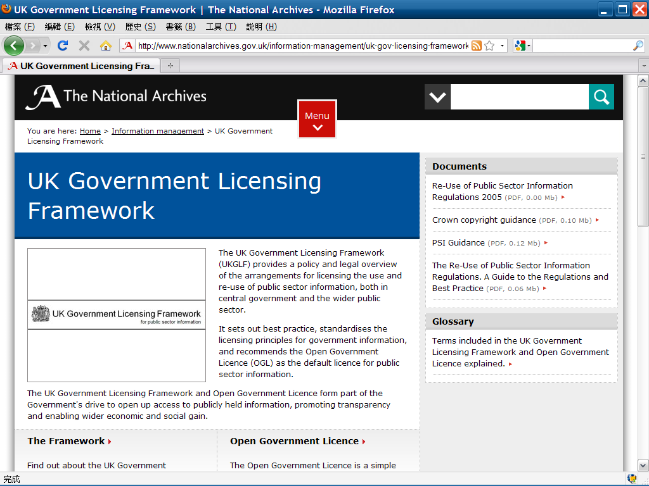

Slide 81
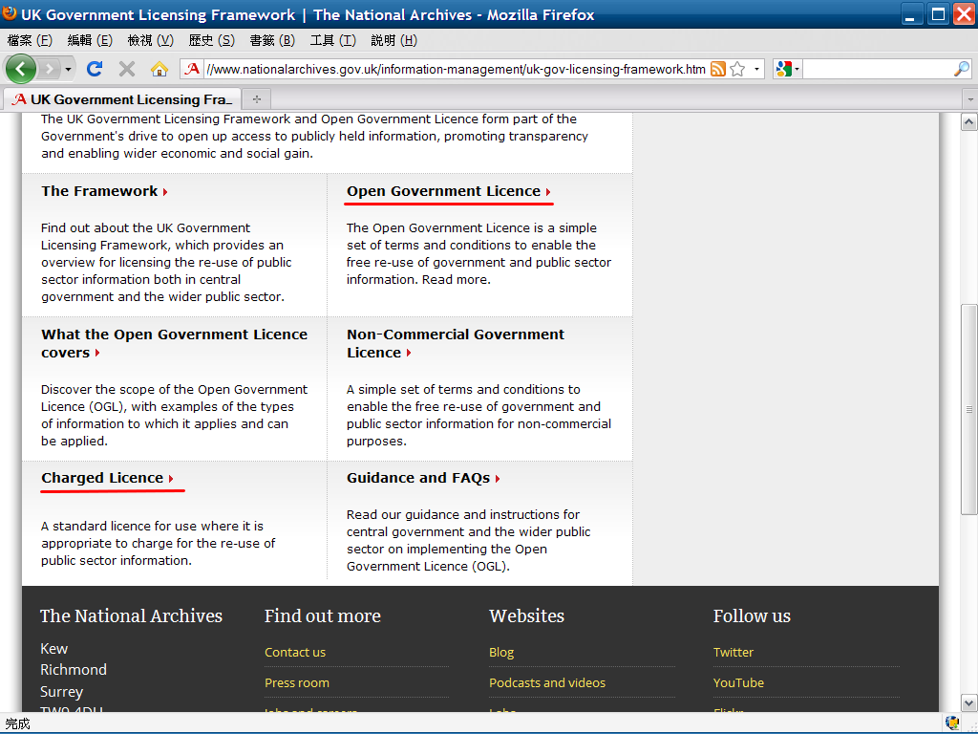

Slide 82
4. The granted Data can't be revoked
Irrevocable

Slide 83
5. No warranties / Correctness timely updating obligation only
Timely update on Correctness

Slide 84
5. No warranties / Correctness timely updating obligation only
Timely update on Correctness

Slide 85
6. The status to use, research, value-add, and redistribute the Data
Use Research
Value-add Redistribute

Slide 86
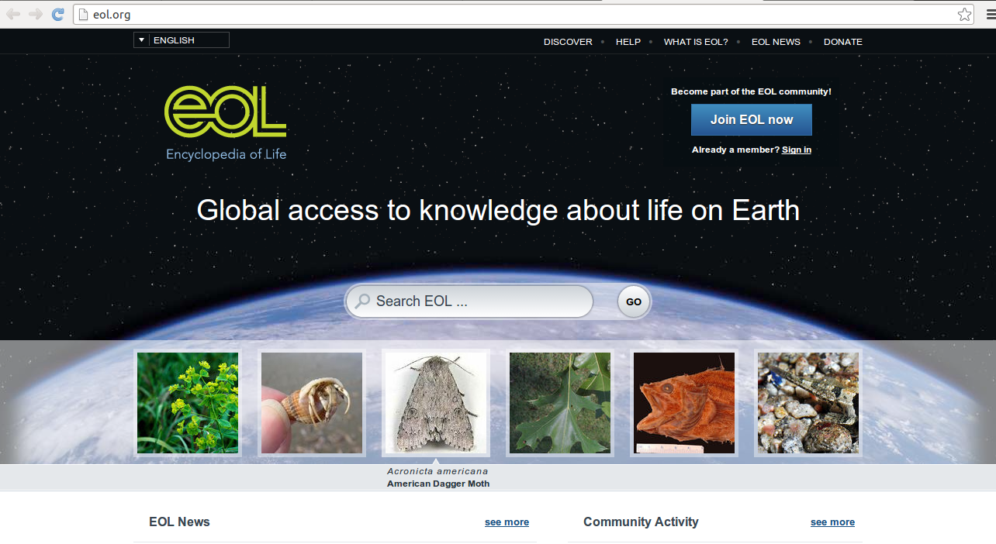

Slide 87
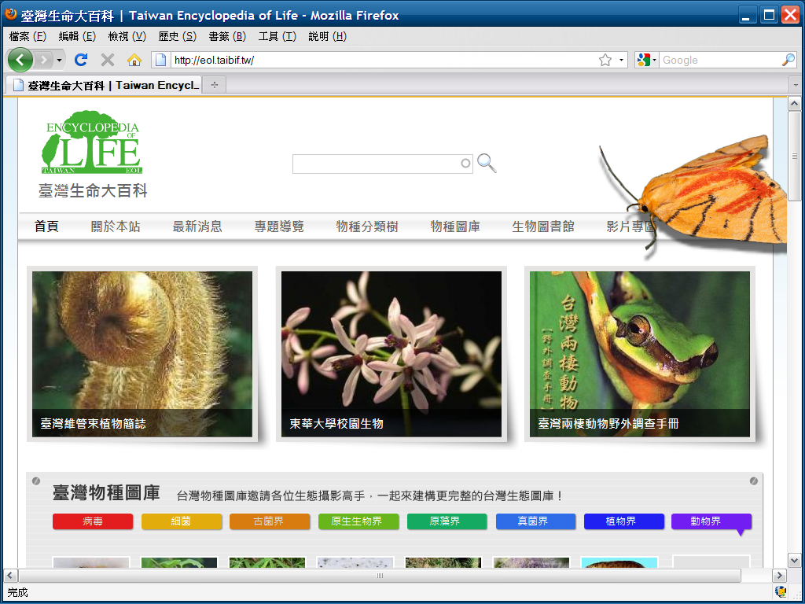

Slide 88
License Agreement
1. 非專屬(non-exclusive)
2. 容許再授權(sublicense)
3. 不可撤回(irrevocable)

Slide 89
Ecosystem
on Data collaboration and Reusing

Slide 90

openlegal openfoundry

Slide 91
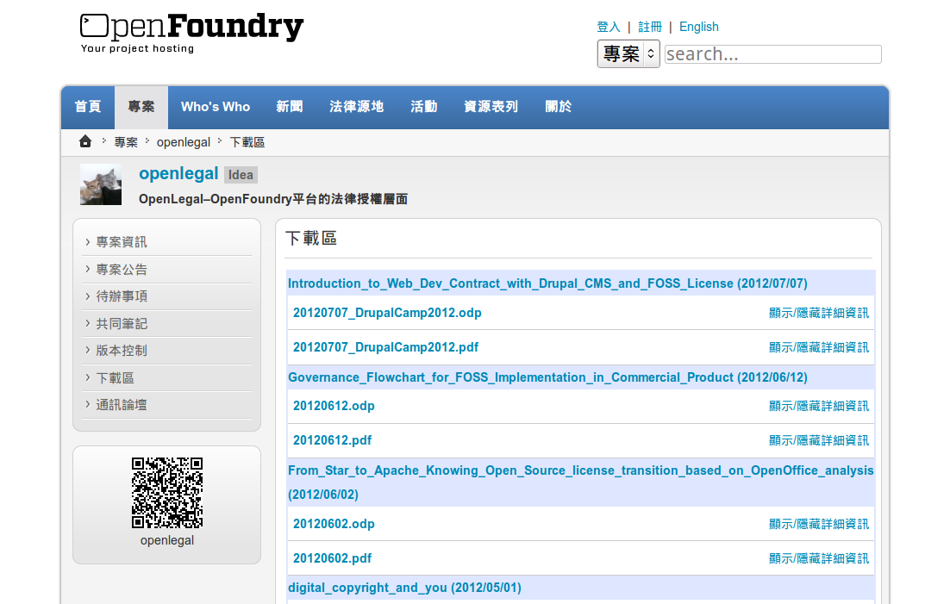
Ctrl+F: 20131121

Slide 92

COPYRIGHT NOTICE
2013 Some Rights Reserved, Lucien C.H. Lin
Except where otherwise noted, content on this slide is licensed under a Creative Commons Attribution-ShareAlike 3.0 Unported license
A statement that the intellectual property rights belong to the original authors must accompany the reproduction and distribution of any part of the content.
THANK YOU
Website: www.openfoundry.org
Phone: 02-2788-3799 ext. 1474
Notes:
<編號>

